Slide 1

Machine learning overview with tensorflow
Evan Komp

Slide 2
Outline
Part 1a: Supervised Machine Learning (SML)
Architecture and general terminology
Prediction Evaluation
Datasets and overfitting
Neural networks (NN) – a type of SML
Loss surface
Enter tensorflow (Jupyter)
Part 1b: Hyperparameters
Activation
Preprocessing hyperparameters
Learning hyperparameters
Regularization
Optimization

Slide 3
1a) Supervised machine learning
Purpose: Given what we know about some data, create a model that will make accurate predictions on new observations

Slide 4

General Architecture
Labels: Outputs
e.g. .
Features: Inputs
e.g. mass
Some ML Model
...
...
Parameters:
Are the model
Do the math
Hyperparameters:
Format of model
Dictate the final parameters

Slide 5
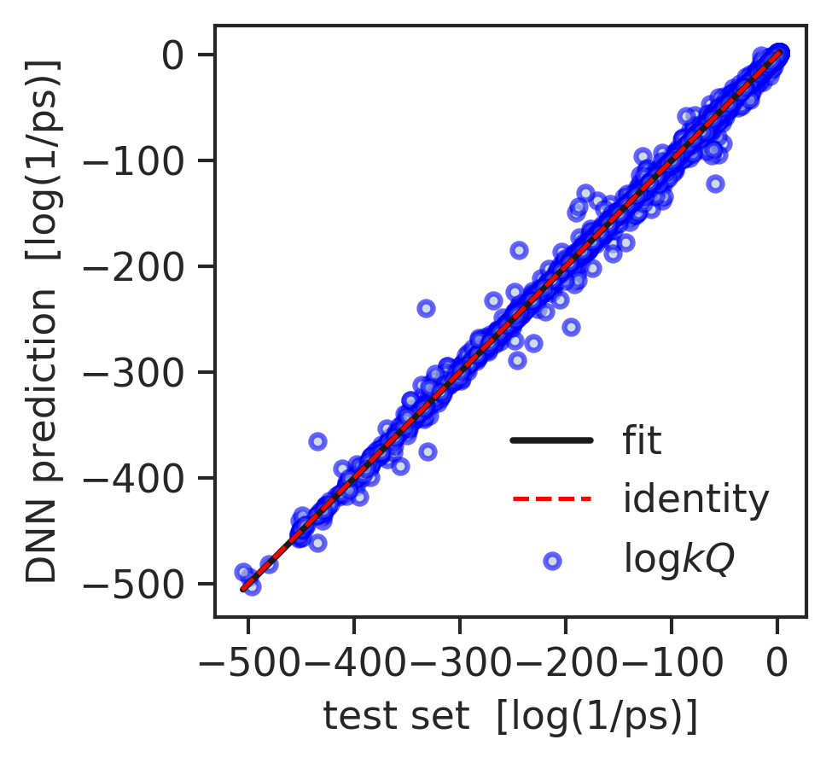
Evaluation
COMPARE PREDICTIONS TO TRUE VALUES
Cumulative metrics: MSE, MAE, mean Euclidian distance …
We can evaluate these metrics for any set of data
Predictions
Label
True

Slide 6


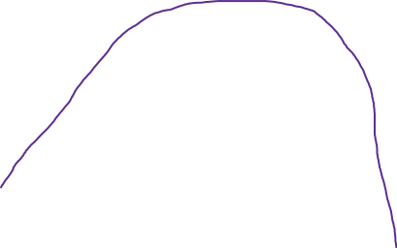


Datasets
Example/sample: one datapoint, a set of features with a label
Val and test help with generalization (avoiding overfitting)
TRAINING SET
VALIDATION
DEVELOPMENT SET
TEST SET
ALL DATA

Slide 7
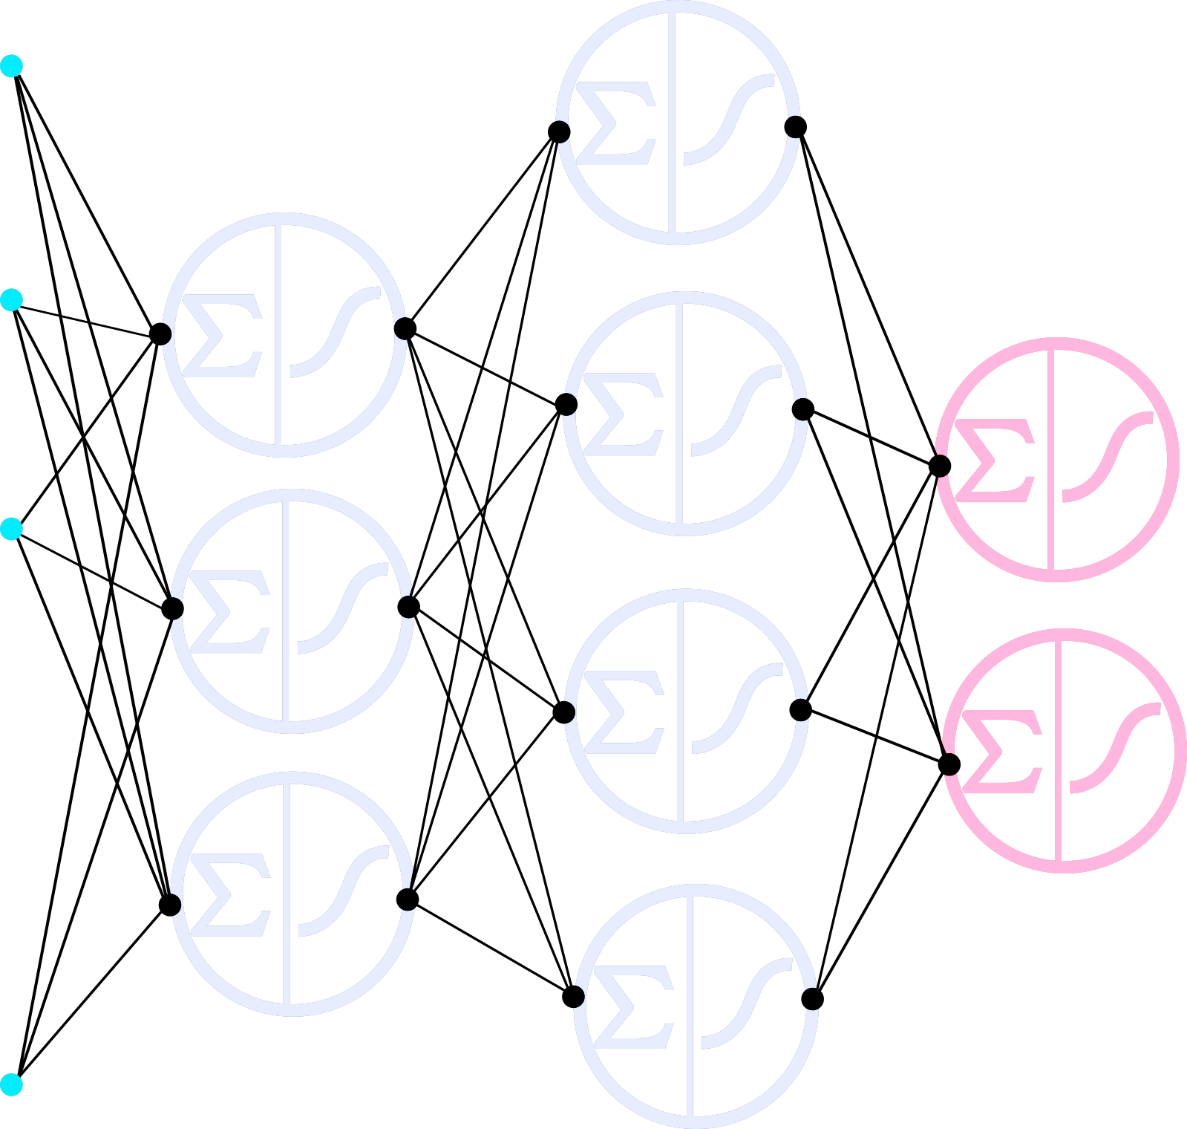
Neural networks
DENSE NN
Labels: Outputs
e.g. .
Features: Inputs
e.g. mass
Some ML Model
...
Output layer
Hidden layer
Input layer

Slide 8
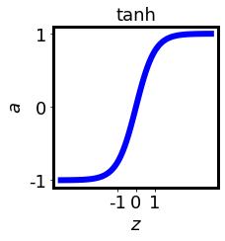
Neurons
DENSE NN
Labels: Outputs
e.g. .
Features: Inputs
e.g. mass
Some ML Model
...
…

Slide 9
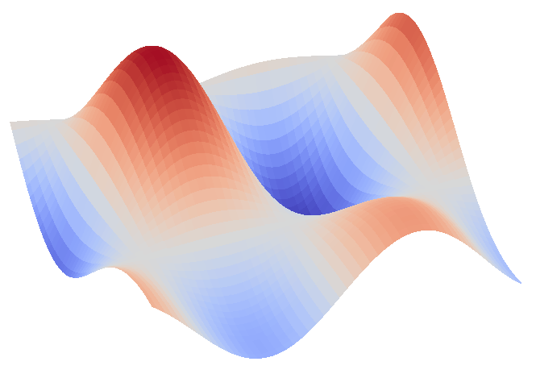
Loss surface
LEARNING
LOSS
Epoch: One iteration through the training data

Slide 10

Implementation in Jupyter

Slide 11
1b) Model options and tuning
Purpose: Define specific architectures/hyperparmeters to address issues with data and modeling

Slide 12
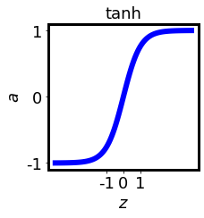
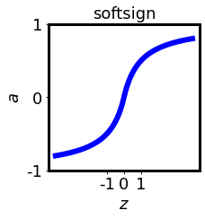
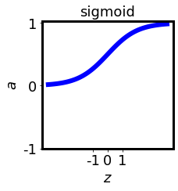
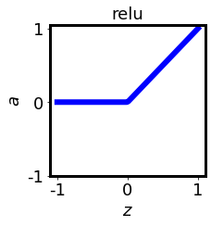
Activations
Activations functions are active near z = 0
From the perspective of a neuron: it can learn quickly near z = 0 (large gradients), it can decide with confidence
WEIRD

Slide 13
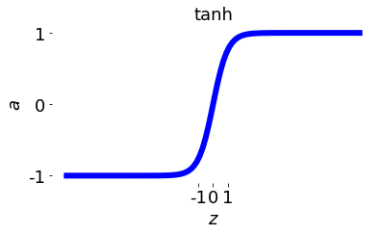
Preprocessing Hyperparameters
NEURON WEIGHTS
PDF
Slow learning (low derivative)
Indistinguishable z
We want a distribution in the active region (near 0) of the activation function

Slide 14
Preprocessing Hyperparameters
STANDARDIZATION
PDF
We want a distribution in the active region (near 0) of the activation function
Standardize (normalize or scale) features to be close to 0
Initialize weights close to 0: small x and small w = small z

Slide 15
Learning Hyperparameters
LEARNING
Mini Batch Training: Make weight changes on smaller batches of data
LOSS
Epoch: One iteration through the training data

Slide 16
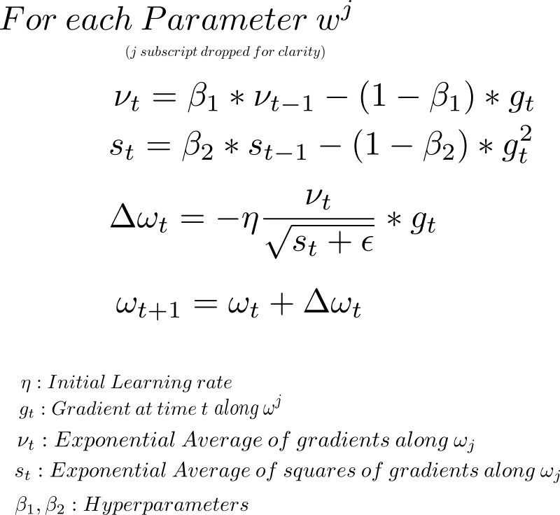
Learning Hyperparameters
Adam:
OPTIMIZER

Slide 17

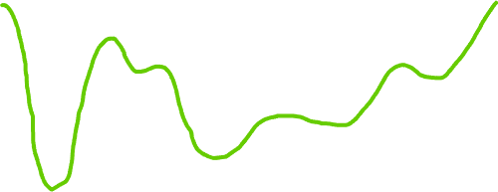
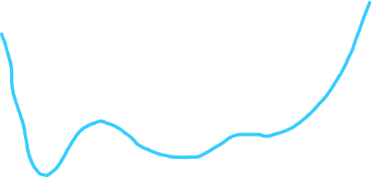
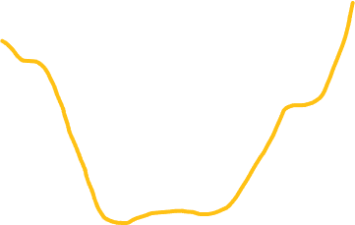

Regularization
Large weights (far from 0) cause overfitting – no one neuron should dominate
Dropout: randomly inactivate neurons during training
L1/2: Penalize large weights

Slide 18


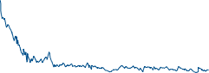
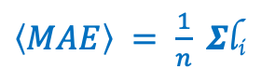

Flow of optimization process
Test Set
Grid Search
Cross Val.
Dev. Set
Initiate Hyps.
Avg. Val. Loss
Train
$\left\langle MAE\right\rangle = \frac{1}{n} Σ$l_{i}
Best
Evaluate
Full Dataset
l₁
l₂
l₃
l₄
l₅
Hyp. Value
Initiate Hyps.
Evaluate
Train final predictor
Error
Train
Training

Slide 19
Model validation schemes
K-fold cross validation lessens effect of randomness
5 models, same hyperparameter/s
Train on 4/5 of the folds, validate on the 5th
Average validation score for better estimate of true performance
TRAINING SET
VALIDATION
Fold 1
Fold 2
Fold 3
Fold 4
Fold 5
DEVELOPMENT SET
TEST SET
https://machinelearningmastery.com/k-fold-cross-validation/

Slide 20
Optimization schemes
Grid search is a robust method of exploring hyperparameters
best value of hyp.
validation error
hyperparameter value
grid of independent models
https://scikit-learn.org/stable/modules/grid_search.html

Slide 21
Implementation in Jupyter

Slide 22
2) Tensorflow and complex models
Purpose: Treat a neural network task as a flow of data through tensor/matrix transformations

Slide 23
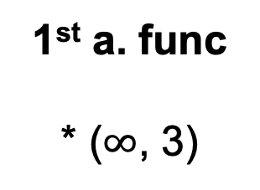
The tensor “flow”
SIMPLE DNN TENSOR FLOW
Input layer with m data points, N features
Output layer with m datapoints, and 1 label
Some ML Model
...
First hidden layer with m datapoints, and 3 units
1st weights
* (N, 3)
1st bias
+ (1, 3)
1st a. func
* ($∞$, 3)
Input (m, N)
1st activation (m, 3)

Slide 24
The keras functional api
This is a way to define and connect these tensor transformations
Every keras.layer.XXXX is just a tensor transformation or instruction
out_tensor = ks.layers.Dense(**kwargs)(in_tensor)
After connecting all tensors, wrap them into a model and compile
Repeat this for a DNN and a more complex model

Slide 25
Implementation in Jupyter

